Slide 1

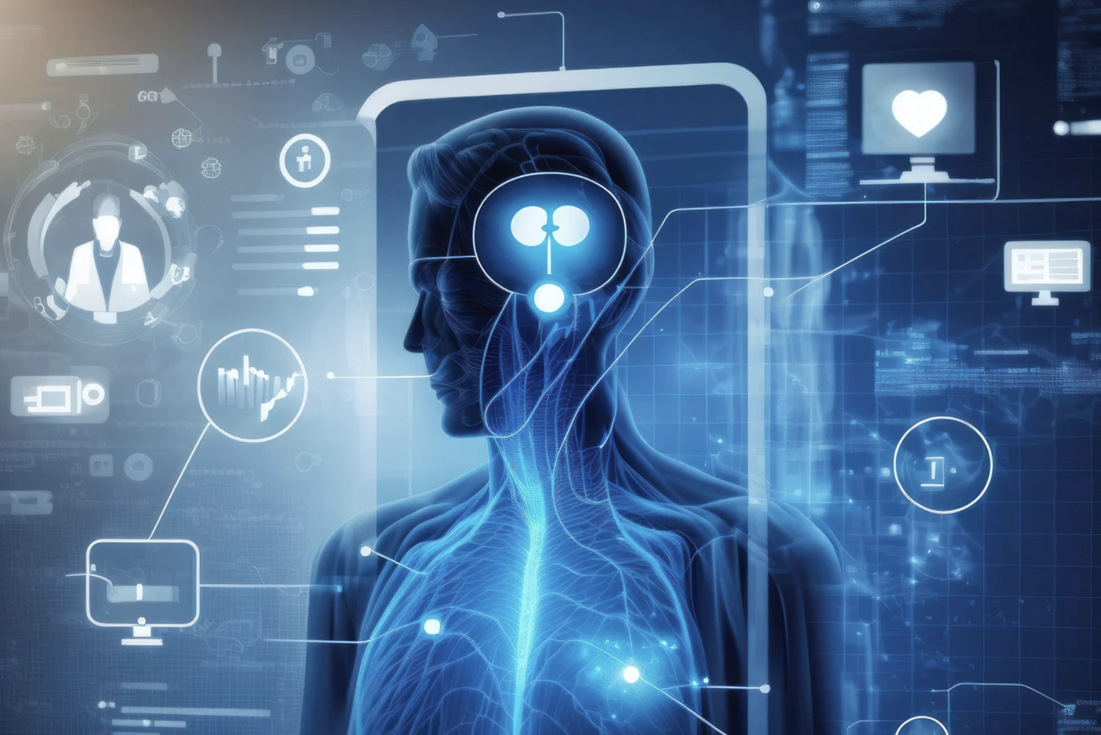
R2GEN2
Fine-tuning Multimodal AI for Radiology
Aayush Verma Ashmita Mukherjee Rishab Mohan Leo Li

Slide 2
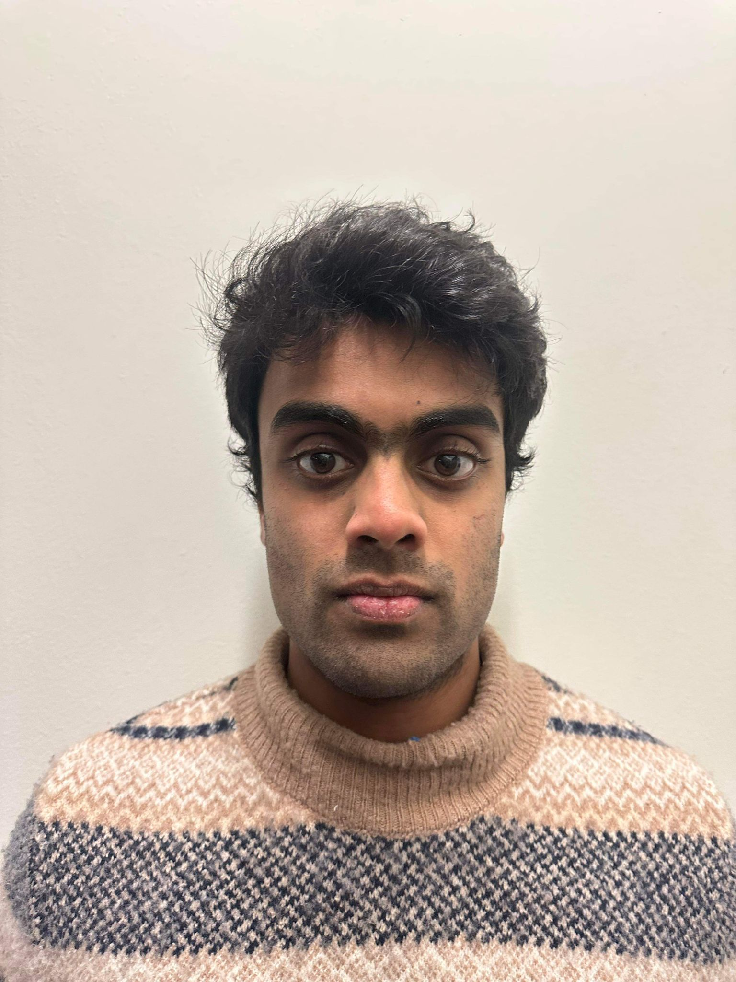
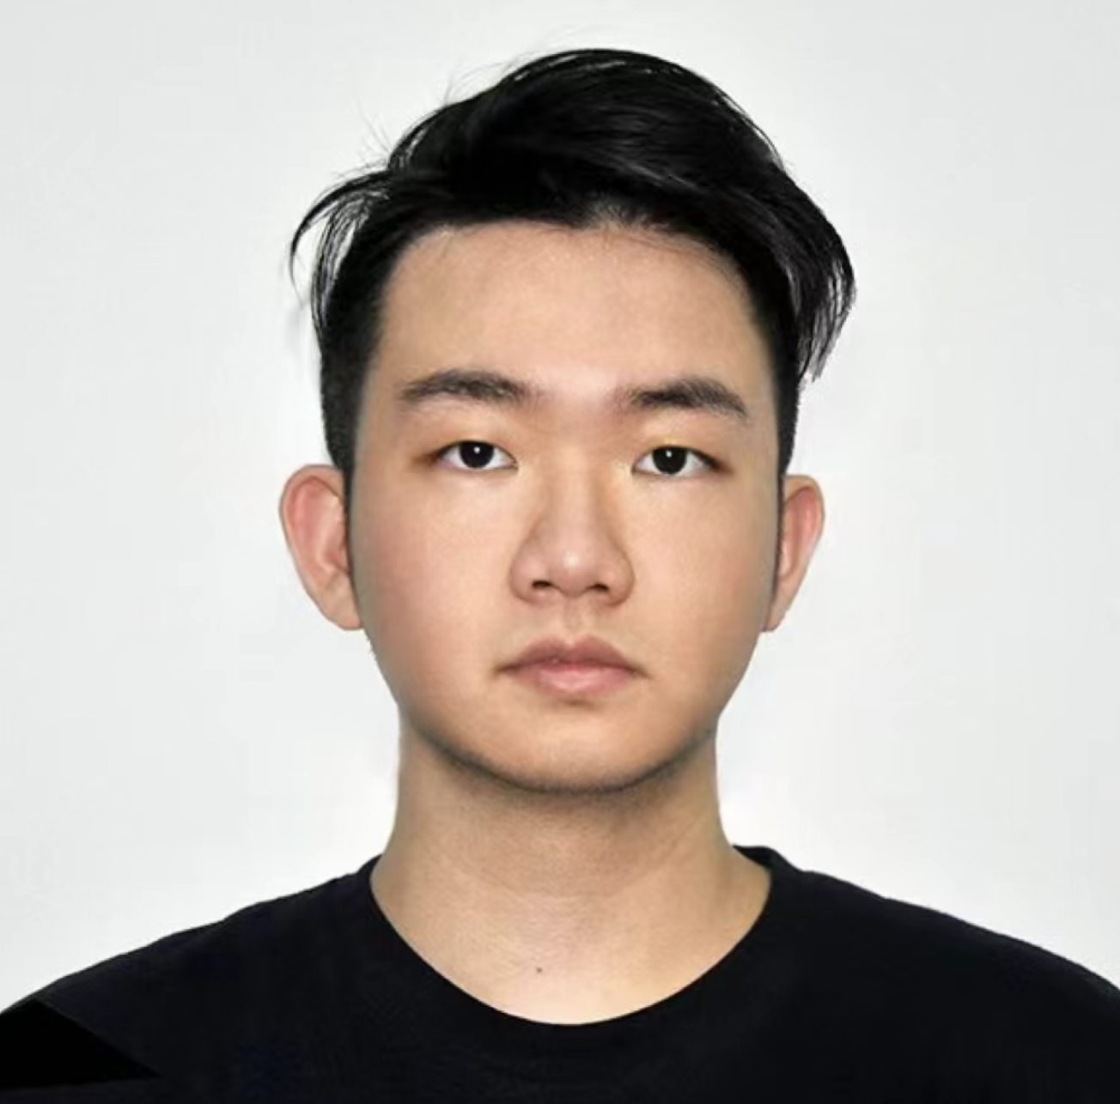
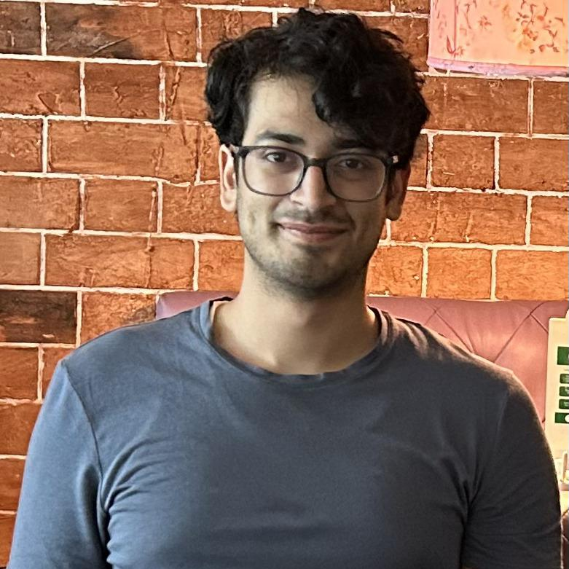
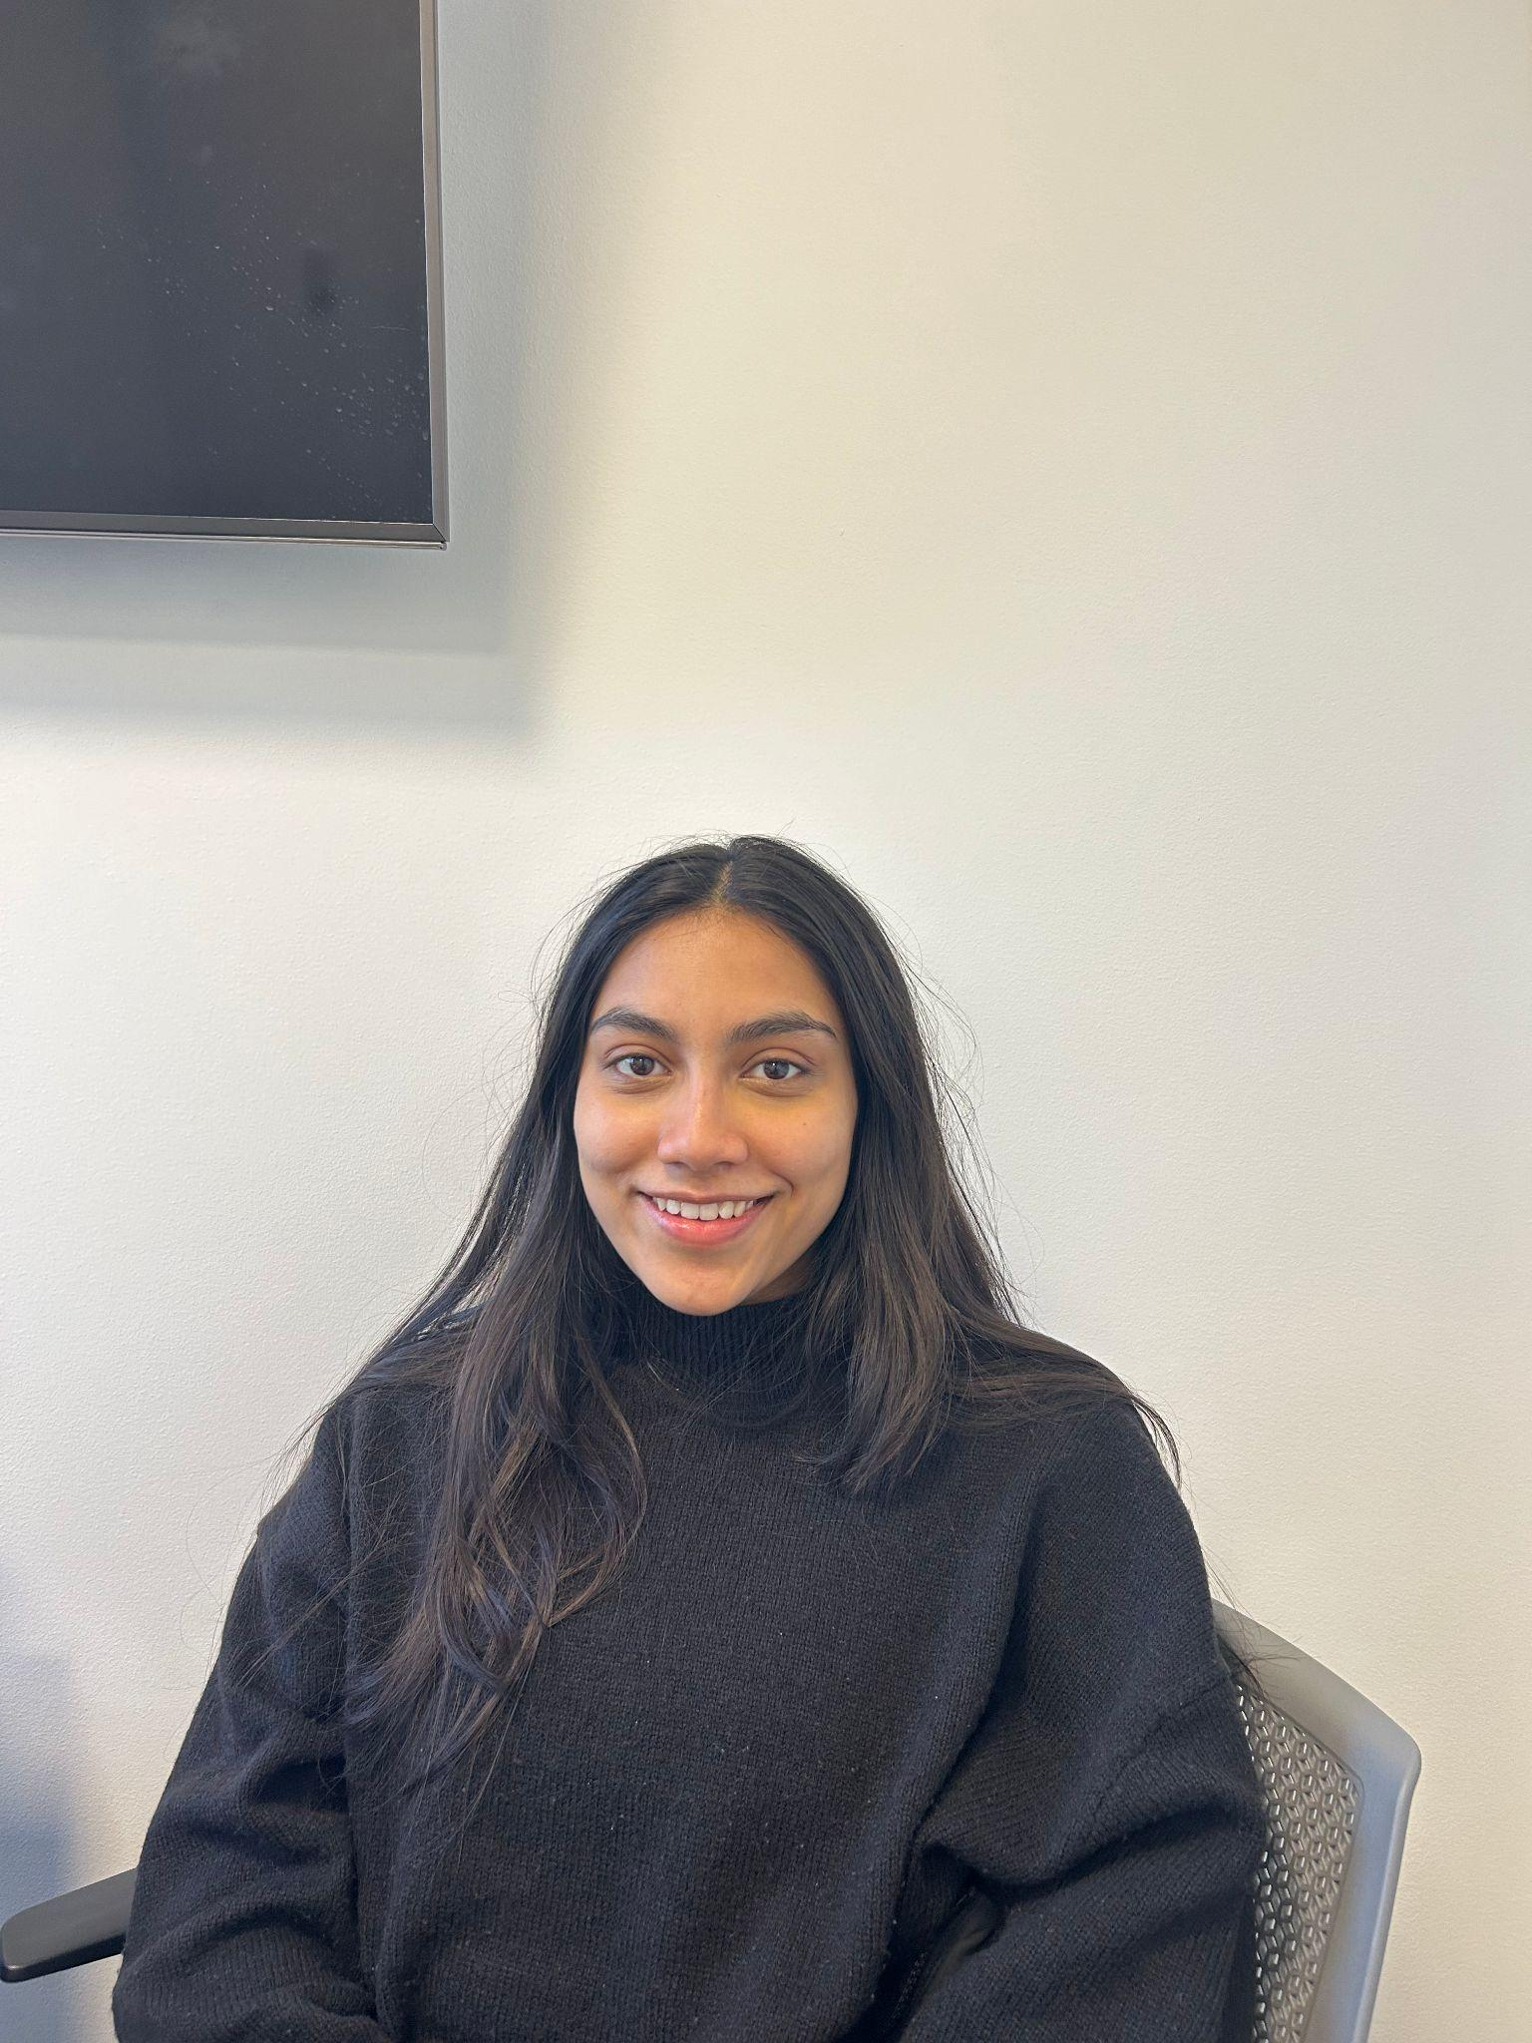
Meet The Team
Rishab Mohan Leo Li Aayush Verma Ashmita Mukherjee

Slide 3
01
PROBLEM STATEMENT
Background and Research Problem

Slide 4
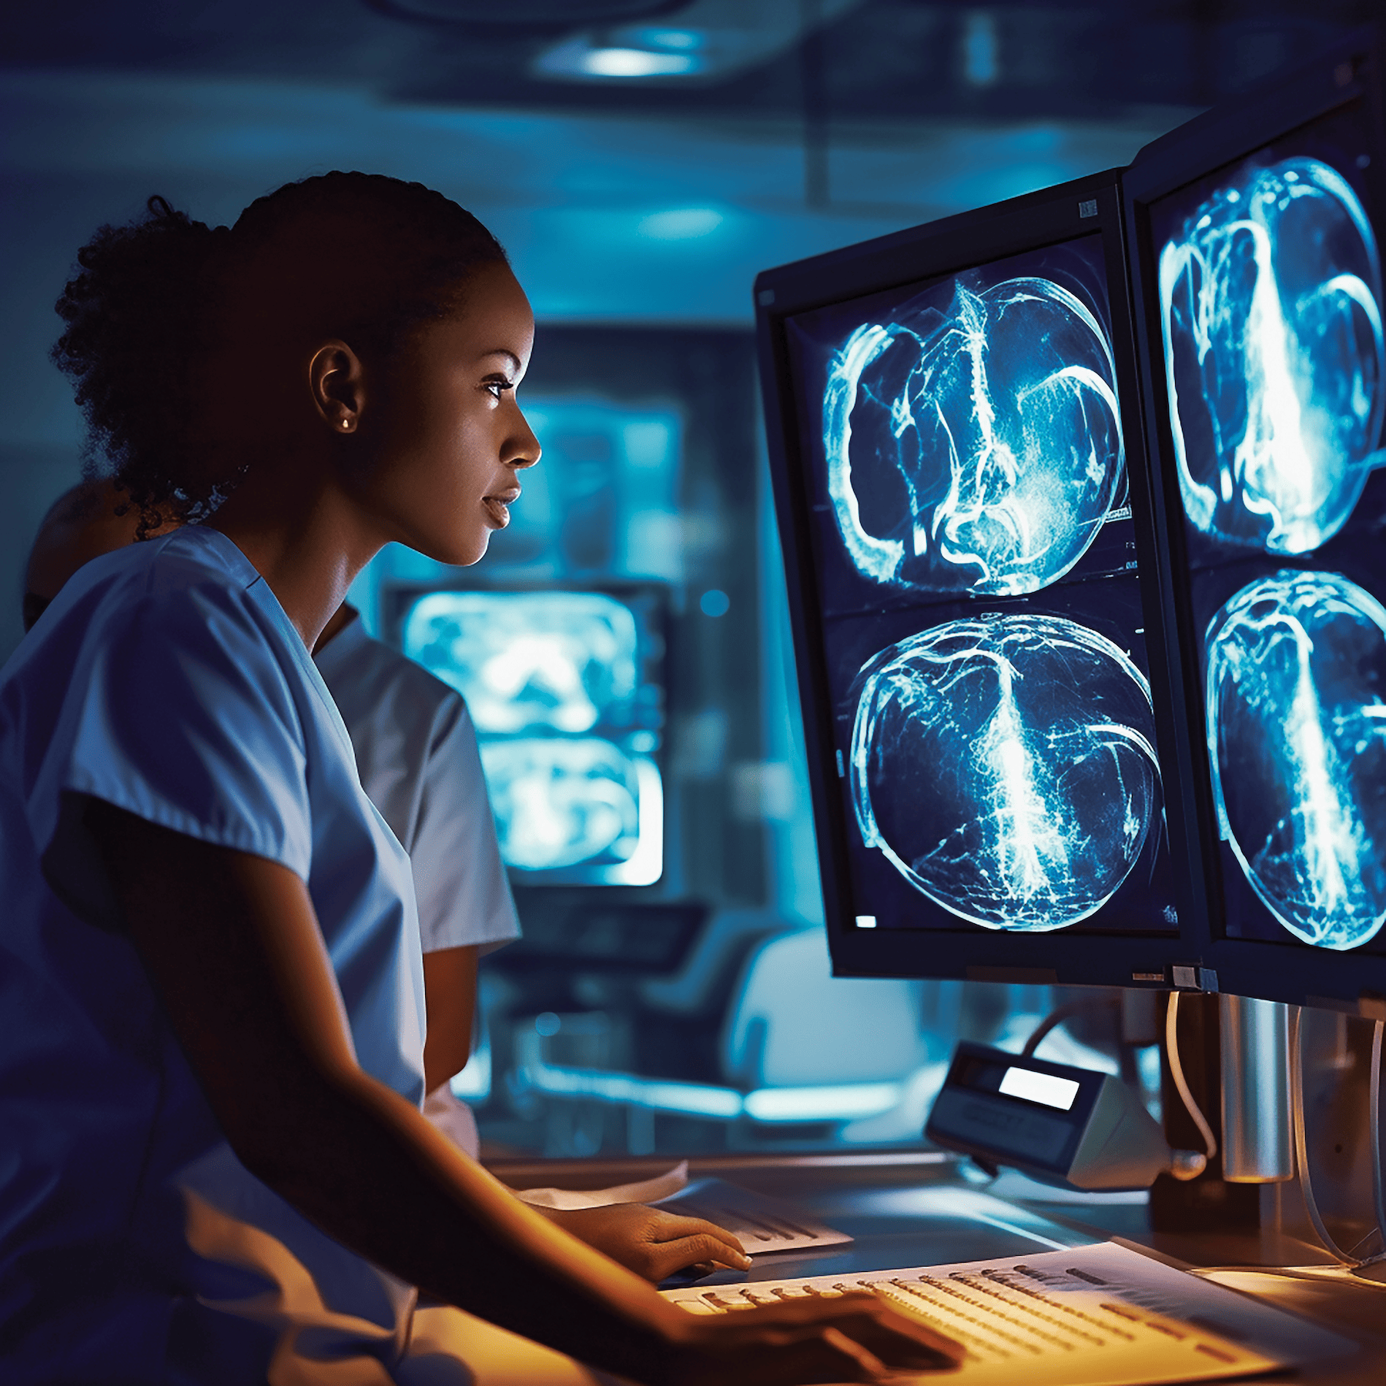

Meet Dr. Cooper
Dr Cooper is a radiologist at IU Health leading a team of accomplished radiologists.
She and her team along with many other radiologists in the USA contend with extreme circumstances and challenges daily.
Ever Increasing Imaging Volume
Increasing Work Hours spilling into personal life
Non Essential Administrative Tasks and Desk Work
Pressure To Maintain Accuracy under Immense stress
We believe AI Integration is the key to address some of their burdens !
1

Slide 5
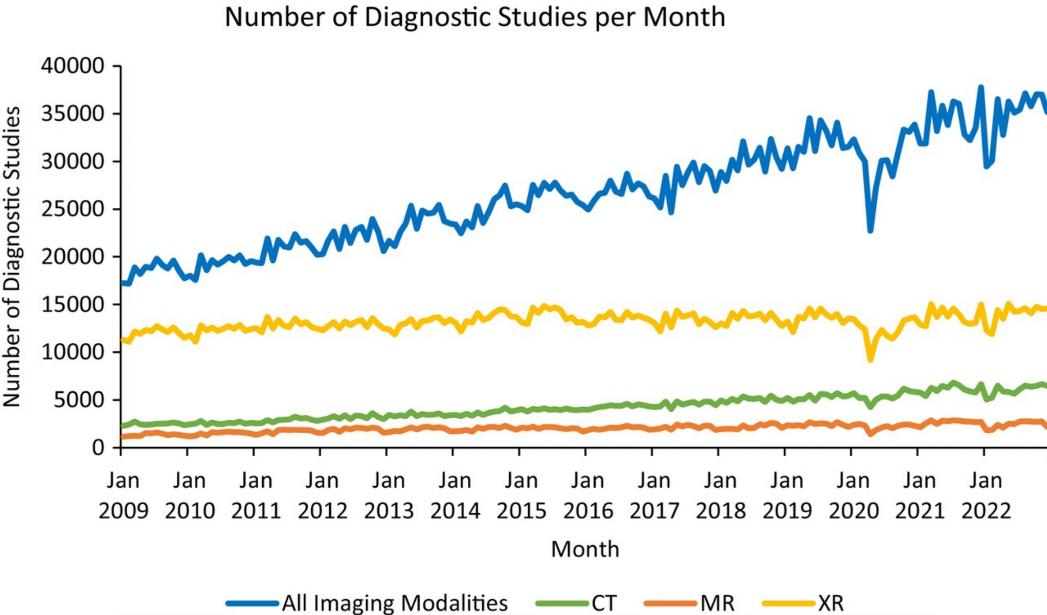
Let’s talk Numbers
Dr. Cooper and her team work with ~35000 studies a Month. This leads to her and her team working more than 35 hours per day total.
~49% of their valuable time is wasted on documentation and desk work*.
In fact, 54% of all Radiologists report experiencing “long-term, unresolved, job-related stress leading to exhaustion, cynicism, and lacking a sense of personal accomplishment.”
Sinsky, C., Colligan, L., Li, L., Prgomet, M., Reynolds, S., Goeders, L., Westbrook, J., Tutty, M., & Blike, G. (2016). Allocation of physician time in ambulatory practice: A time and motion study in 4 specialties. Annals of Internal Medicine, 165(11), 753. https://doi.org/10.7326/m16-0961 https://appliedradiology.com/Articles/playing-with-fire-burnout-among-radiologists-a-growing-concern https://pubmed.ncbi.nlm.nih.gov/7551783/#:~:text=Data%20were%20collected%20on%202345,systematic%20variation%20in%20reporting%20time.
2

Slide 6
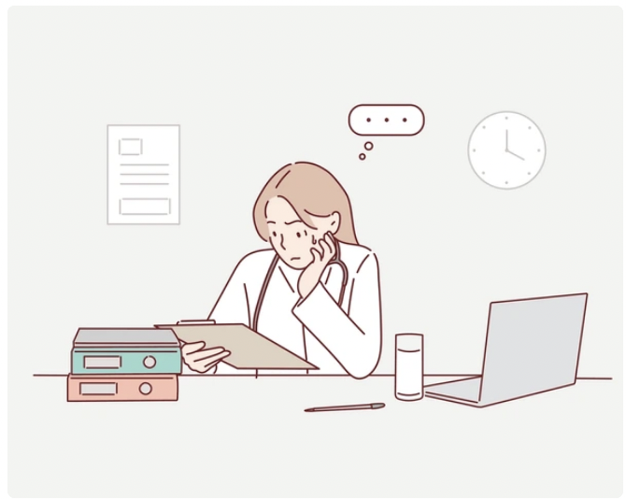




Challenges for enterprise VLMs to deliver personalized solutions.
Radiologists develop formulaic easy to reproduce report writing styles unique to themselves.
HIPAA Compliance Laws restrict the flow of data slowing AI Innovation.
Accuracy and Factual correctness thresholds.
Enterprise Solutions are not the Answer
Lack of standardization in reporting styles hinders the adoption of generalized AI
Ensuring data security and compliance with regulations like HIPAA remains a critical barrier to implementation.
Not holistically trained in medical data leading to factual correctness errors.
3

Slide 7
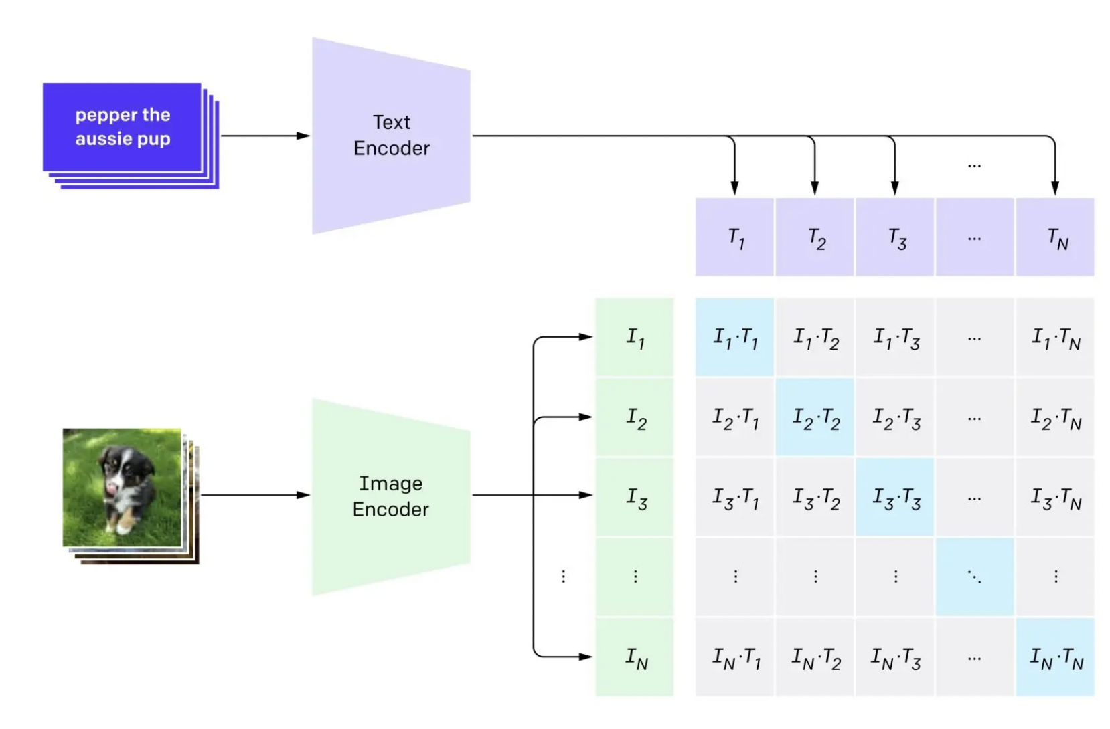



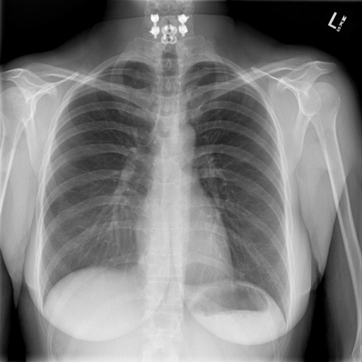
Literature review focused on significant advancements in AI: Advancement of vision-language models and automated systems for healthcare applications.
Vision Language Models
AI/ LLMs in Healthcare
VLMs in Healthcare
Reports
R2Gen2
Brings Transformer Architecture to Vision Models ( GPT with Eyes ! )
We surveyed Current Work Involving Feature Extraction from Images in a structured format.
Current work consists of converting Labels to Findings and Impressions
Some authors also leveraged AI to create customized Patient Plans
We combine the intents of previous work to propose R2Gen2
Harnessing Vision language Models we synthesize Reports and Features directly from Images!
Radiology
4

Slide 8
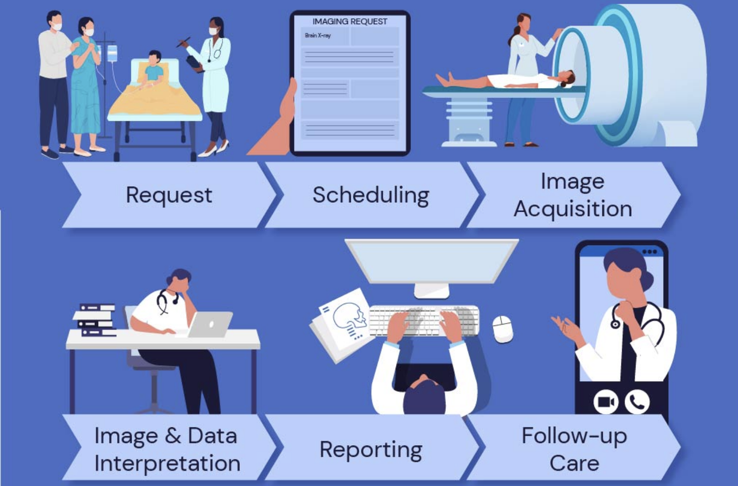
R2Gen2 in the Radiology Life Cycle
R2Gen2
R2Gen2
5

Slide 9
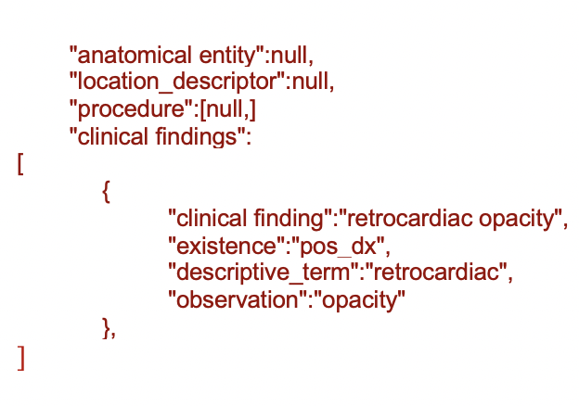
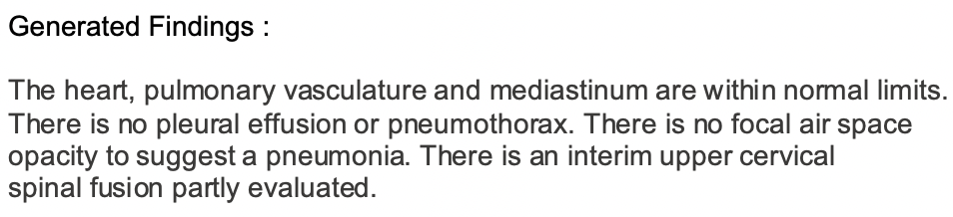
R2Gen2 for Advanced Medical Feature Extraction and Personalized
Radiology Findings Reporting
R2Gen2
Feature Extraction Model
Radiology Findings Reporting Model
Automatically extracts relevant features.
fracture lines, soft tissue swelling, or lung opacities
JSON output easily integrates with radiology reporting systems or EMRs
"fracture: true", "location: distal radius", "severity: displaced"
Adapt to each radiologist's distinct reporting style. - Ensures consistent use of terminology and formats across all reports
Provide preliminary findings to streamline workflow.
Reduces the time spent manually transcribing findings
6

Slide 10

R2Gen2 in Action!
7

Slide 11
02
DATA OVERVIEW
Exploratory Analysis and Preprocessing

Slide 12
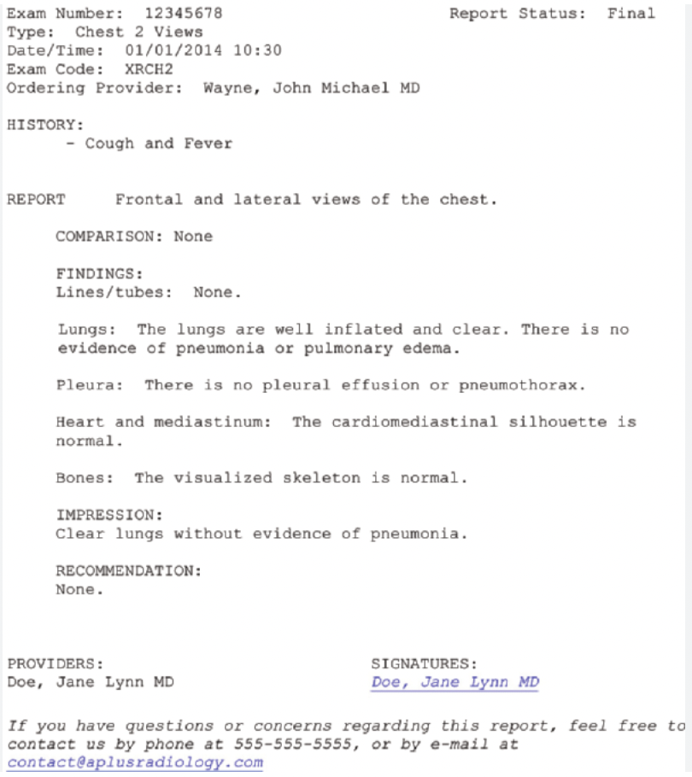
Example of a real radiology report
R2Gen2’s Target Area !
8

Slide 13
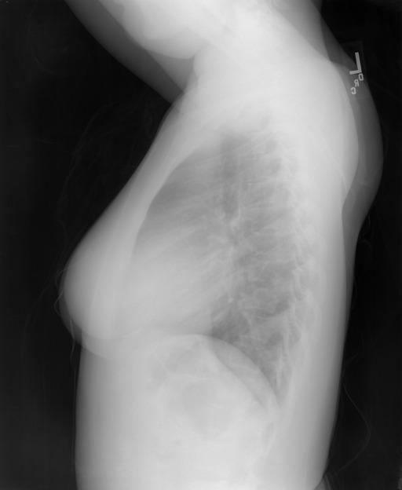
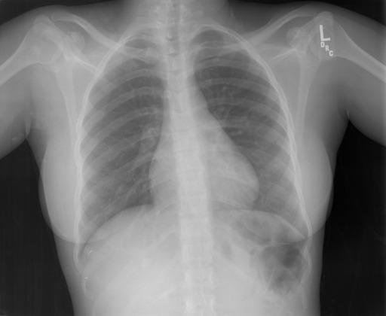
A dataset of Chest X-ray images and reports sourced from the Indiana Network for Patient Care was utilized.
Label="INDICATION">Positive TB test
Label="FINDINGS">The cardiac silhouette and mediastinum size are within normal limits. There is no pulmonary edema. There is no focal consolidation. There are no XXXX of a pleural effusion. There is no evidence of pneumothorax.
Label="IMPRESSION">Normal chest x-XXXX.
<Affiliation>Indiana University</Affiliation>
<LastName>Kohli</LastName>
<ForeName>Marc</ForeName>
<Initials>MD</Initials>
<Author Valid Y/N ="Y">
<LastName>Rosenman</LastName>
<ForeName>Marc</ForeName>
<Initials>M</Initials>
<PublicationType>RadiologyReport</PublicationType>
Our research is focused on accurate generation of findings
9
Indication Findings Impression Affiliation Radiologist Technician Report Type
Source Link : https://openi.nlm.nih.gov/imgs/collections/NLMCXR_reports.tgz

Slide 14
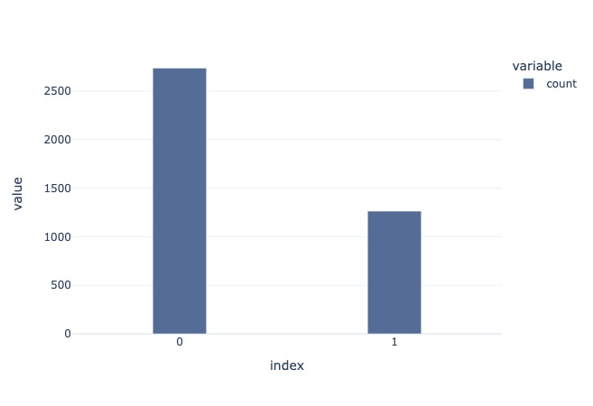
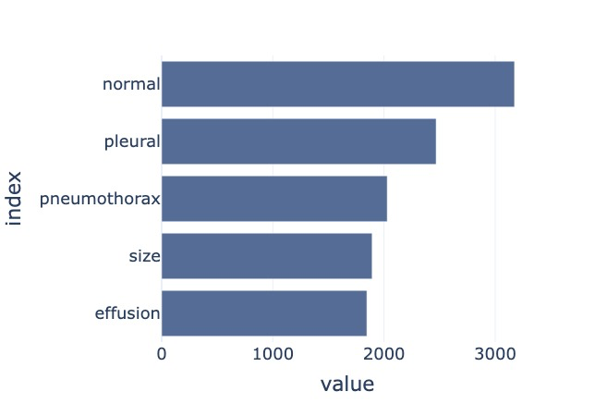
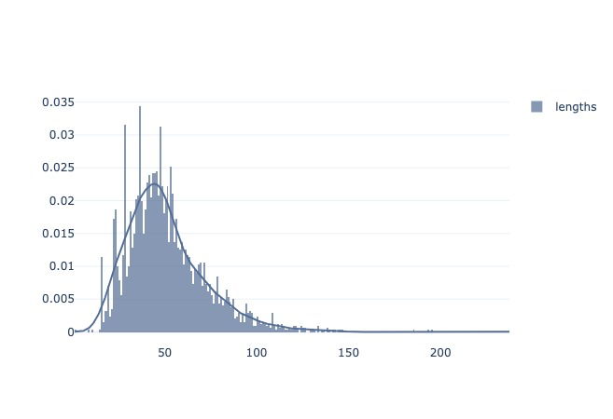
textual exploratory data analysis unlocked a deeper understanding of the dataset.
Normal v/s Abnormal Report Count
Frequently used terms in Reports
Distribution of Report Lengths
0 - Normal
1 - Abnormal
67.56% of the reports are categorized as normal.
32.43% are classified as abnormal.
The most frequent terms in the dataset include "pleural", "normal", "focal", "lungs”.
This aligns with the typical language and findings found in chest X-ray reports.
The radiology reports are typically ~50 words in length.
This enables the report generation process for the VLM, to produce accurate and efficient outputs.
10

Slide 15
03
METHODOLOGY
Workflow and Model Fine Tuning

Slide 16


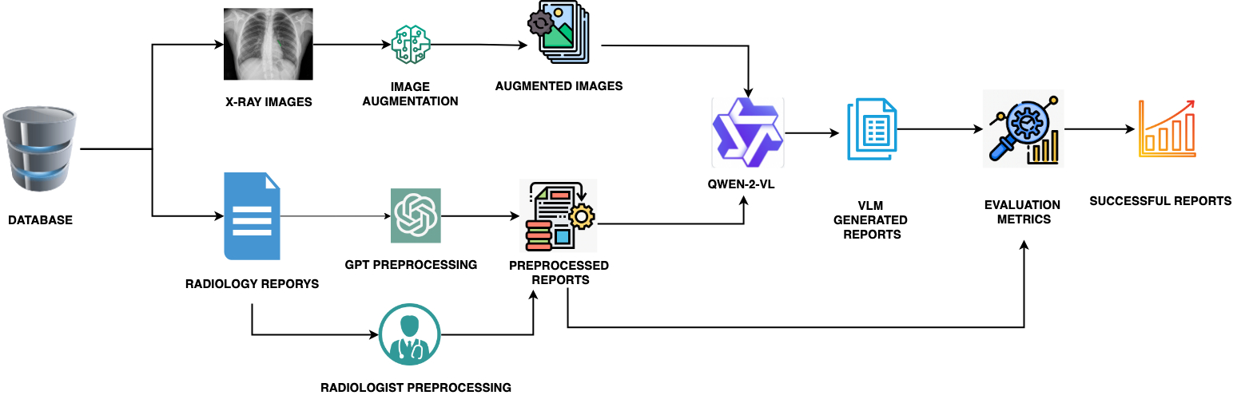



R2Gen2 Under the Microscope
Image Preprocessing
11

Slide 17
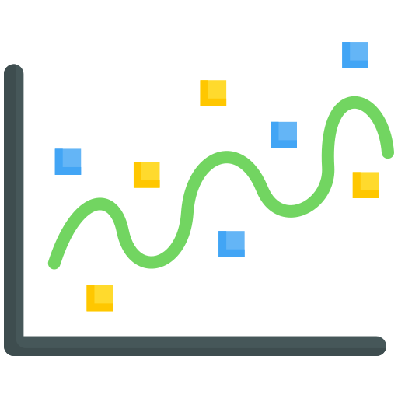
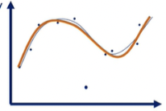

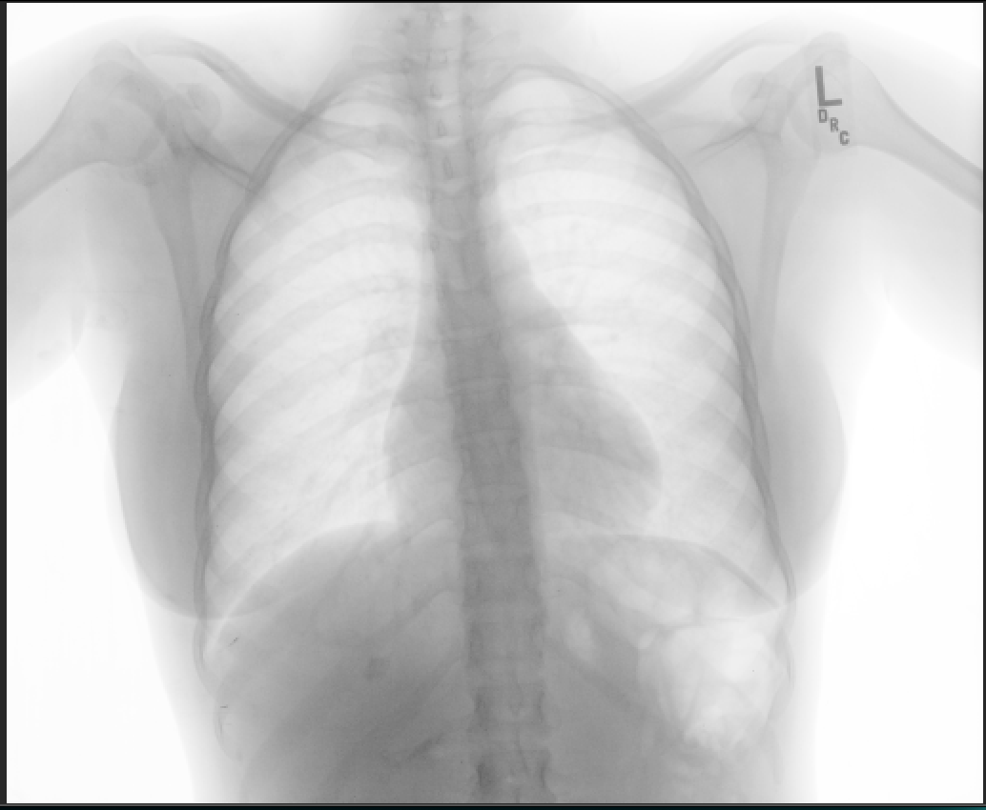
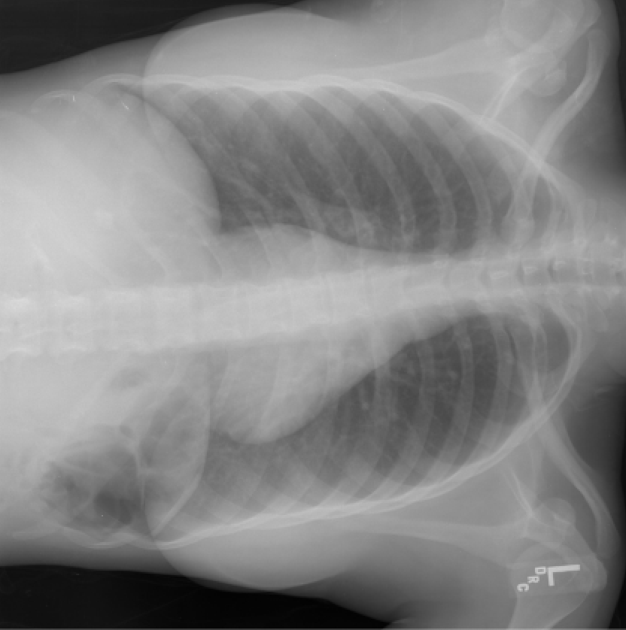
Given the limited size of the dataset, it was necessary to generate additional samples to mitigate the risk of overfitting.
Transformers are particularly prone to overfitting when trained on small datasets.
This approach boosts robustness and generalizability.
Original Image
Color Inversion
Rotation
AUGMENTATION
12

Slide 18
R2Gen2 Under the Microscope
Image Preprocessing
Report Text Preprocessing
13

Slide 19
Imputation of anonymized medical findings from 37% of the reports compromising the dataset's utility for research.
Example of a Report with missing information
Redacted Text
Findings: The cardiac silhouette and mediastinum size are within XXXX limits. There is no pulmonary edema. There is no focal consolidation. There are no XXXX of a pleural effusion. There is no XXXX of pneumothorax.
To reconstruct the de-identified dataset, we implemented the following strategies
Collaborated with a certified radiologist.
Reconstructed findings maintaining overall privacy.
The radiologist cross-referenced original images with redacted data.
Restored critical observations while ensuring the clinical meaning and context of the data were intact
14

Slide 20
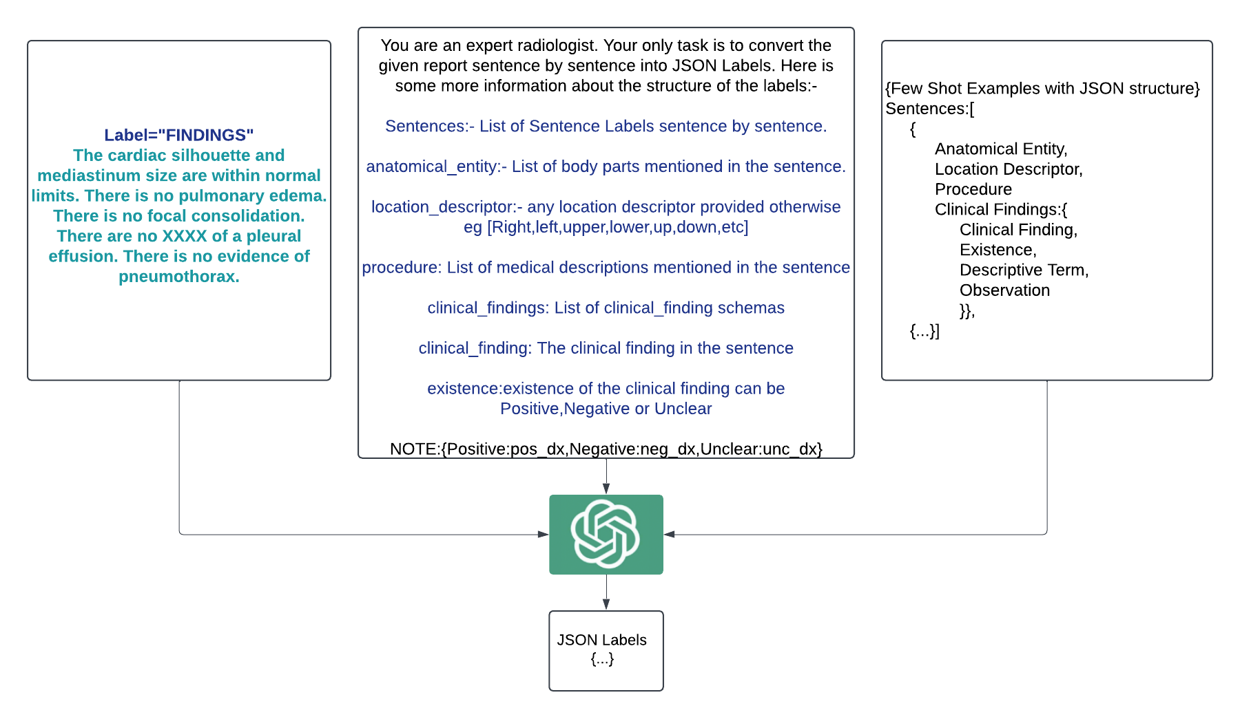

Reports are transformed into structured JSON labels for the Structured Fine tuned Model
Findings Text from Report
Instruction Prompt for GPT 4o Mini
GPT 4o Mini
Example JSON Output structure
JSON Labels for Structured Model Input
15

Slide 21
Example of the original report plus newly generated labels by GPT-4o Mini.
Each sentence → structured JSON, detailing the anatomical entity, the procedure performed, and the specific clinical findings associated with that entity
{
"anatomical entity":null,
"location_descriptor":null,
"procedure":[null,]
"clinical findings":
[
{
"clinical finding":"retrocardiac opacity",
"existence":"pos_dx",
"descriptive_term":"retrocardiac",
"observation":"opacity" },
{
"clinical finding":"atelectasis",
"existence":"unc_dx",
"observation":"atelectasis" },
{
"clinical finding":"or small effusion",
"existence":"unc_dx",
"descriptive_term":"or small",
"observation":"effusion", }
]
}
Retrocardiac opacity which may represent atelectasis and or or small effusion is stable.
16

Slide 22
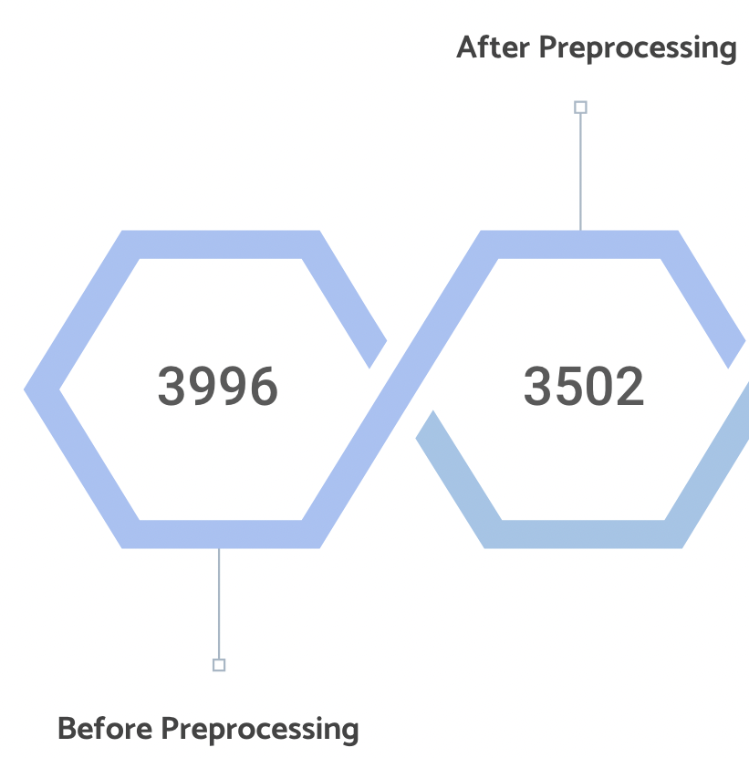
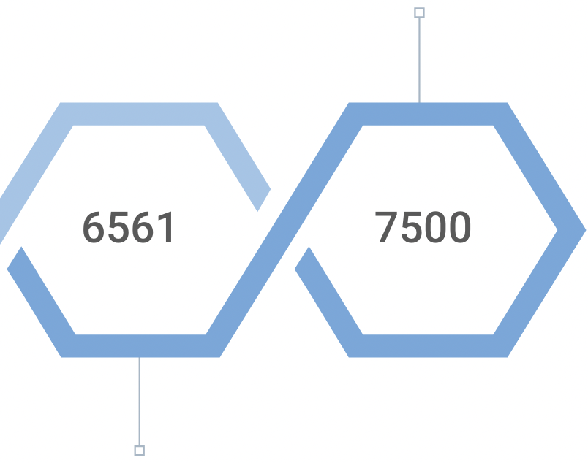
Preprocessing resulted in a 12% reduction in X-ray reports, and augmentation increased the number of images by 14%.
Number of Chest X-Ray Reports
Number of Chest X-Ray Images
After Preprocessing
3996
7500
Before Preprocessing
Before Preprocessing
17

Slide 23
R2Gen2 Under the Microscope
Image Preprocessing
Fine tuning Qwen-2
18

Slide 24

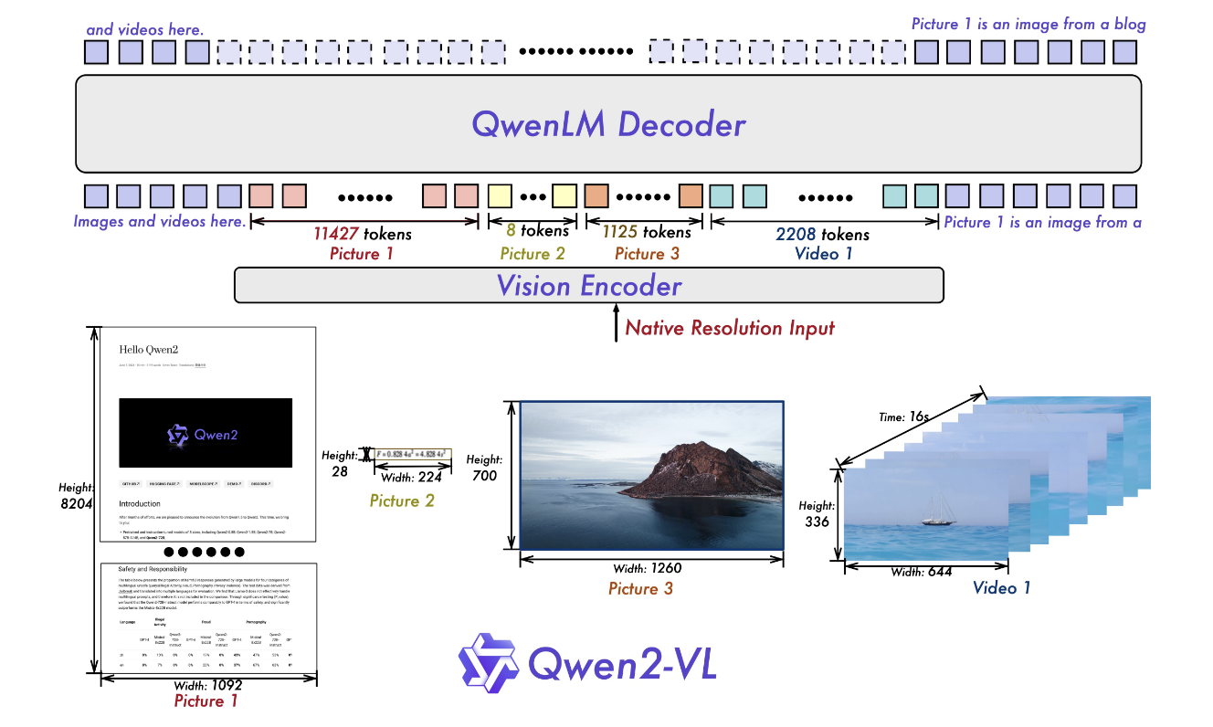

Our Literature Review of vision models revealed that Qwen 2 demonstrated superior performance on Image comprehension and Document semantics benchmarks, surpassing LLaMA and GPT.
Advanced multimodal architecture
Handles Arbitrary Image sizes and resolutions
Positional understanding across text, visual, and video domains
Models
Qwen-2-VL-7B
Llama-3.2-11B
GPT-4o-Mini
Benchmarks
91.6
94.5
-
DocVQA
InfoVQA
84.3
80.1
81.7
MMBench1.1
80.7
79.4
76.0
19
Notes:
Qwen2-VL can handle arbitrary image resolutions, mapping them into a dynamic number of visual tokens, offering a more human-like visual processing experience.
Decomposes positional embedding into parts to capture 1D textual, 2D visual, and 3D video positional information, enhancing its multimodal processing capabilities.

Slide 25

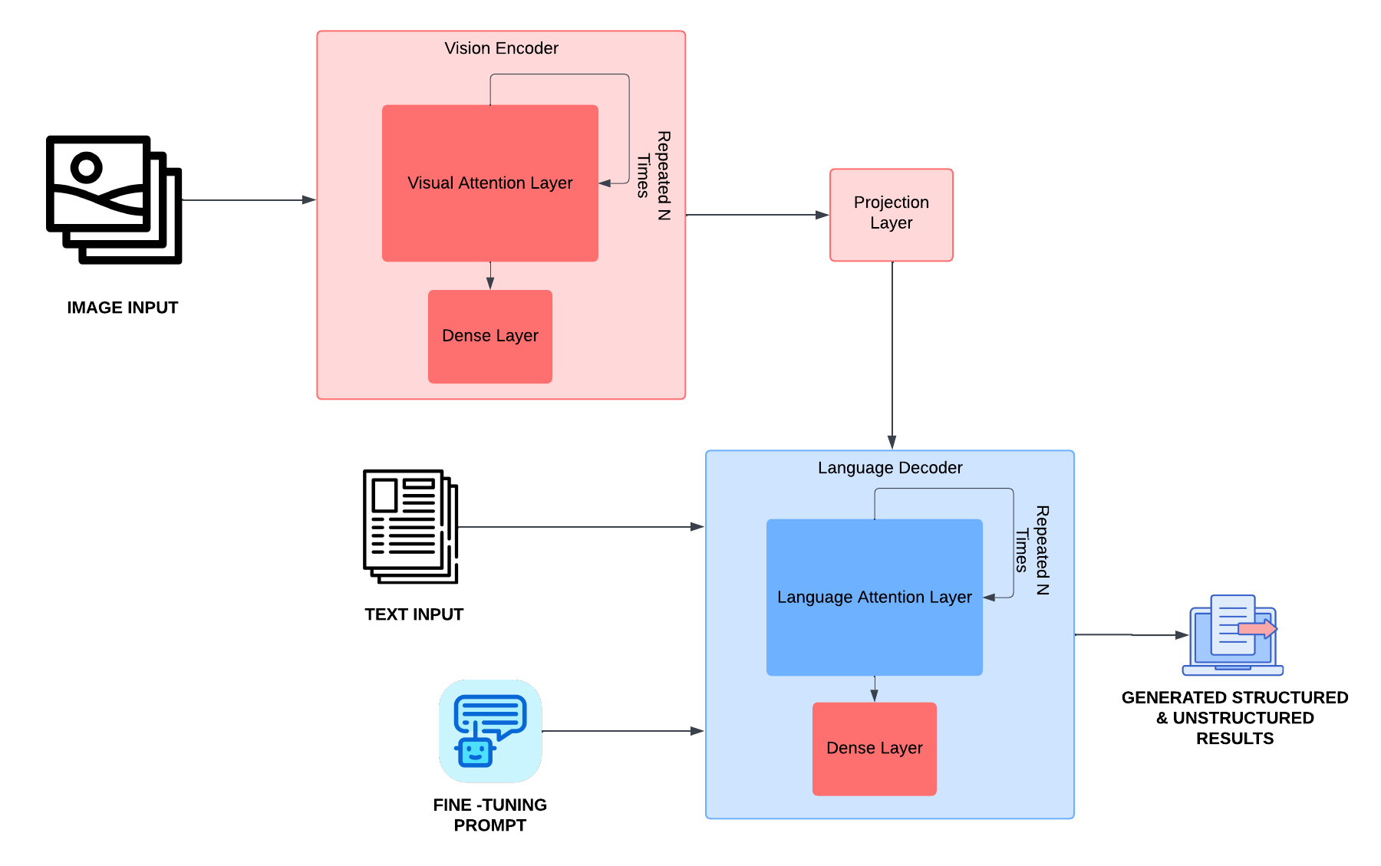
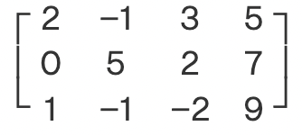
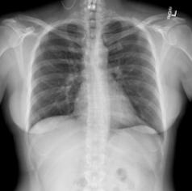

How to train your VLM
Understands the X-Ray image
just as a radiologist would.
Trainable
Non Trainable
Translates image data and combines it with text data to make sense of both
A skilled assistant that emulates the radiologist’s tone
Instructs to communicate in the personalized style of the doctor.
20

Slide 26
R2Gen2 Under the Microscope
Image Preprocessing
Output Generation
21

Slide 27


We have two specialized models to streamline the workflow: one focused on extracting relevant features and second dedicated to generating detailed reports in the radiologist's personalized tone boosting customization.
Structured Fine-tuned Model
Unstructured Fine-tuned Model
Purpose: Designed for customization, translating X-rays into a comprehensive radiology findings report tailored to the reporting style of the radiologist
Use: Rapid prototyping. Drafting of reports during time-sensitive scenarios.
Purpose: Extract and distill clinical findings from X-rays into structured JSON labels.
Use: Metadata filtering. Data Analysis.
22

Slide 28
R2Gen2 Under the Microscope
Image Preprocessing
Evaluation Metrics
23

Slide 29
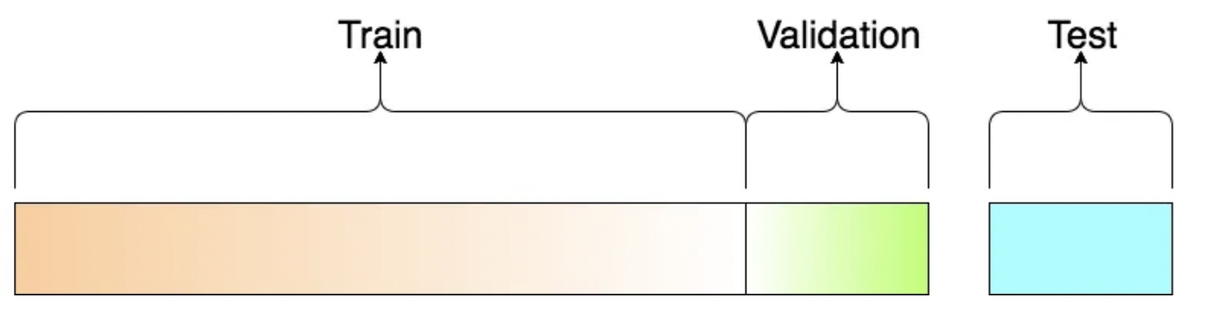

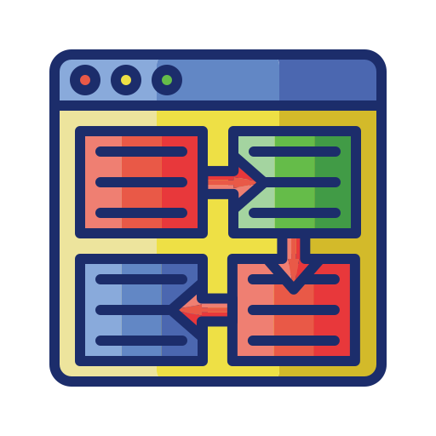

Test data and evaluation methods used to assess the performance of both models.
90 %
5 %
5 %
%. of Records
3150
175
175
No. of Records
Text Similarity
Semantic Understanding
Clinical Evaluation
GLUE
ROUGE
Custom JSON Overlap
BERT Precision
BERT Recall
Radiologist Review
24

Slide 30
04
RESULTS
Novelties, Model Performance and Next Steps

Slide 31
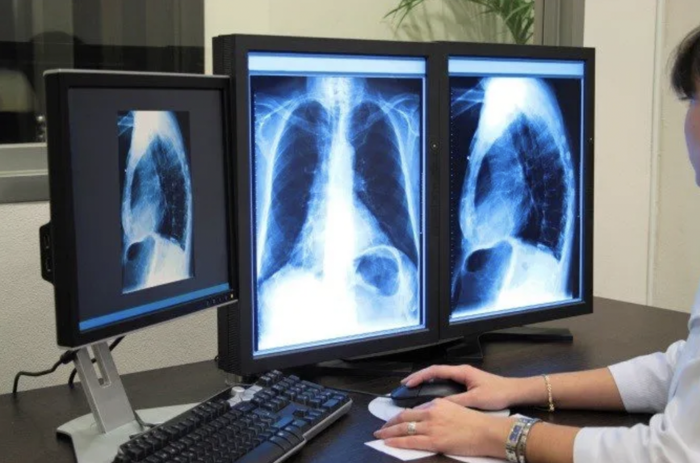
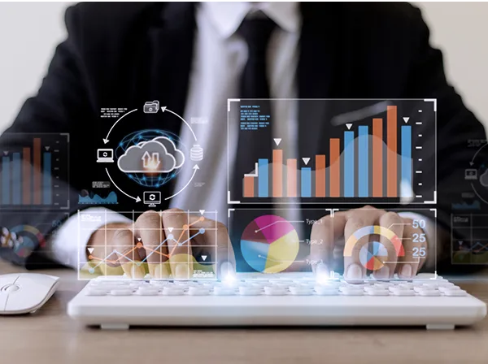

Novelties we developed during our Journey
Personalized Report Generation Assistant
Open Source Dataset Contribution
Customized Evaluation Metric
VLM customized to mimic the specific reporting styles of individual radiologists and perform data analysis via feature extraction
Collaborated with a certified radiologist to decode dataset.
Created a new, curated open source dataset.
Development of our own token overlap metric for structured output generation ( JSON ).
25

Slide 32

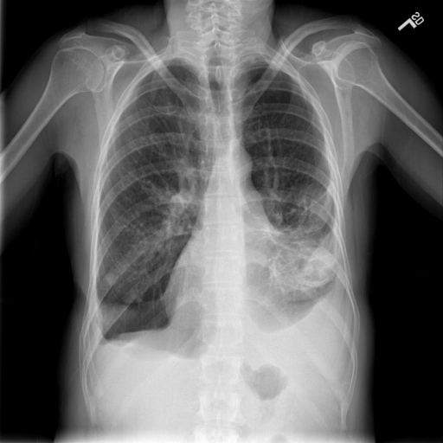
GPT 4o V/s R2Gen2
The right lung appears darker, suggesting a potential pneumothorax (collapsed lung).The left lung has visible opacities, which might suggest consolidation or mass effect.The heart size and borders seem slightly shifted, likely secondary to the findings in the lung.The right hemidiaphragm seems elevated, which is often associated with pneumothorax or loss of lung volume.
The heart size is enlarged. There is left lower lobe airspace disease identified. There is moderate left pleural effusion. No visualized pneumothorax. Surgical suture material noted.
Using Public Large Language Models does not guarantee security and HIPAA compliance.
Writing style is generic and not specific to hospital/team
Possess limited medical knowledge.
R2Gen2 is Privately Hosted and does not leave Hospital System IT Architecture.
Writing tailored to IU standards.
Has learned the meanings of medical terms and providing accurate reports.
Incorrect Partially Correct Correct
26

Slide 33
Structured and unstructured model results
Structured Model Results
Customized JSON evaluation metric score
0.7632
Unstructured Model Results
Metrics
GLUE
ROUGE-1
ROUGE-2
ROUGE-L
ROUGE-LSum
BERT
Precision
BERT
Recall
Report Generation Model
0.8302
0.8132
0.7616
0.8139
0.8144
0.9134
0.8675
0.8302
0.8132
0.7616
0.8139
0.8144
0.9134
0.8675
27

Slide 34


Next Steps for R2Gen2
Implement model pruning techniques .
The model's size leads to slower inference times.
Model Overfitting
MIMIC-CXR dataset, with < 200,000 studies
Findings extraction and customized generation model
An aftercare suggestion framework using Retrieval Augmented Generation
28

Slide 35
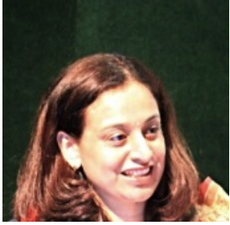

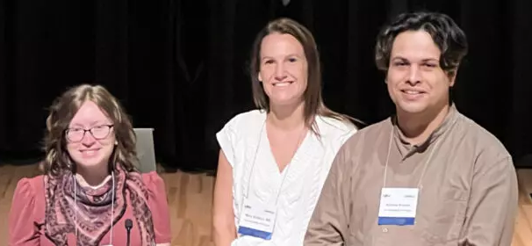
Special Thanks
Dr. Anjalie Verma, MBBS, DNB (Radiology)
A Certified Radiologist In India For Helping with Data Imputation and Output Evaluation
Dr. Utku Pamuksuz, PHD
Our Supervisor, Mentor for helping us overcome challenges and get to the finish line.
We would also like to thank our Instructional Assistants for advice with every small hiccup and round the clock availability.
Tegan Keigher, MS
Mary Erikson, MS
Andrew Alvarez, MS
29

Slide 36

Questions?
Please redirect any further questions to :-
aayushv2001@uchicago.edu
ashmitam@uchicago.edu
rmohan22@uchicago.edu
leoli0907@uchicago.edu

Slide 37
APPENDIX

Slide 38
Meet Dr. Cooper
54% of Radiologists report experiencing “long-term, unresolved, job-related stress leading to exhaustion, cynicism, detachment from job responsibilities, and lacking a sense of personal accomplishment.”
Dr Cooper Is a radiologist at the IU Health hospital.
She and her team work with upwards of 13000 X-Rays a Month. This leads to her and her team working more than 35 hours per day altogether.
50% of this time is wasted in documentation work*.
Because Radiologists like Dr. Cooper have such heavy load
they have developed a formulaic reporting style which is unique to every team and hospital.
This hampers AI Adoption due to it being generalized.
Hospital Systems like IU Health need to have a large amount of quality data for analysis to spur on improvement.
Current Techniques focus on creating unstructured data leaving a large quantity of data uncaptured.
There is a focus on data security to adhere to HIPAA
Sinsky, C., Colligan, L., Li, L., Prgomet, M., Reynolds, S., Goeders, L., Westbrook, J., Tutty, M., & Blike, G. (2016). Allocation of physician time in ambulatory practice: A time and motion study in 4 specialties. Annals of Internal Medicine, 165(11), 753. https://doi.org/10.7326/m16-0961

Slide 39
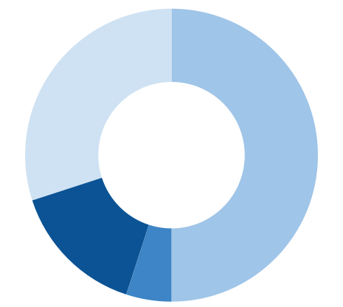
BACKGROUND
Time with Patients
30%
Documentation Work
50%
Administrative Tasks
5%
Miscellaneous Tasks
15%
Radiology is among the top medical specialties experiencing burnout, with an average of 47.7 work hours per week and pressures from both clinical responsibilities and the need to keep up with advancements in imaging technology.

Slide 40
FINDINGS - BEFORE AND AFTER
Example of the original report alongside the newly generated labels by GPT-4o Mini illustrates the transformation:
Each sentence is now represented as a structured JSON object, detailing the anatomical entity, the procedure performed, and the specific clinical findings associated with that entity
Each sentence from the report is converted into a structured JSON format
Original Report
[{"anatomical entity":null, "location_descriptor":null, "procedure":[null,] "clinical findings":[{ "clinical finding":"retrocardiac opacity", "existence":"pos_dx", "descriptive_term":"retrocardiac", "observation":"opacity" }, { "clinical finding":"atelectasis", "existence":"unc_dx", "observation":"atelectasis" }, { "clinical finding":"or small effusion", "existence":"unc_dx", "descriptive_term":"or small", "observation":"effusion", } ]},
Retrocardiac opacity which may represent atelectasis and or or small effusion is stable.
Right Lung is otherwise clear.
No pneumothorax.
NG tube tip below the diaphragm.
{"anatomical entity":"lungs" "location_descriptor":Right, "procedure":[null] "clinical findings":[{ "clinical finding":"clear", "existence":"neg_dx", "observation":"clear" } ]},
{"anatomical entity":null, "location_descriptor":null, "procedure":[null] "clinical findings":[{ "clinical finding":"pneumothorax", "existence":"neg_dx", "observation":"pneumothorax" }]},
{ "anatomical entity":"diaphragm", "location_descriptor":null, "procedure":[null] "clinical findings":[null] }]}"""}

Slide 41
LITERATURE REVIEW
Large Language Models
Vision Language Models
Generalization in Healthcare AI: Evaluation of a Clinical Large Language Model
InMD-X: Large Language Models for Internal Medicine Doctors
GP-VLS: A general-purpose vision language model for surgery
PA-LLaVA: A human pathology specialized large language vision assistant
Other Healthcare
Radiology-Llama2: Best-in-Class Large Language Model for Radiology
R2GenGPT: Radiology Report Generation with Frozen LLMs
RaDialog: A Large Vision-Language Model for Radiology Report Generation and Conversational Assistance
Vision Transformer and Language Model Based Radiology Report Generation
Visual Prompt Engineering for Medical Vision Language Models in Radiology
Our Research Area
Radiology

Slide 42
DATA OVERVIEW
The Data comprising 3996 radiology reports and 6561 associated images of Chest X-Rays is sourced from the Indiana Network for Patient Care.
Data Source : Indiana Network for Patient Care
Data Description: 3996 radiology reports and 6561 associated images of Chest X-Rays.
Source Link : https://openi.nlm.nih.gov/imgs/collections/NLMCXR_reports.tgz
1486 Reports with XXXX, 3735 sentences with XXXX

Slide 43
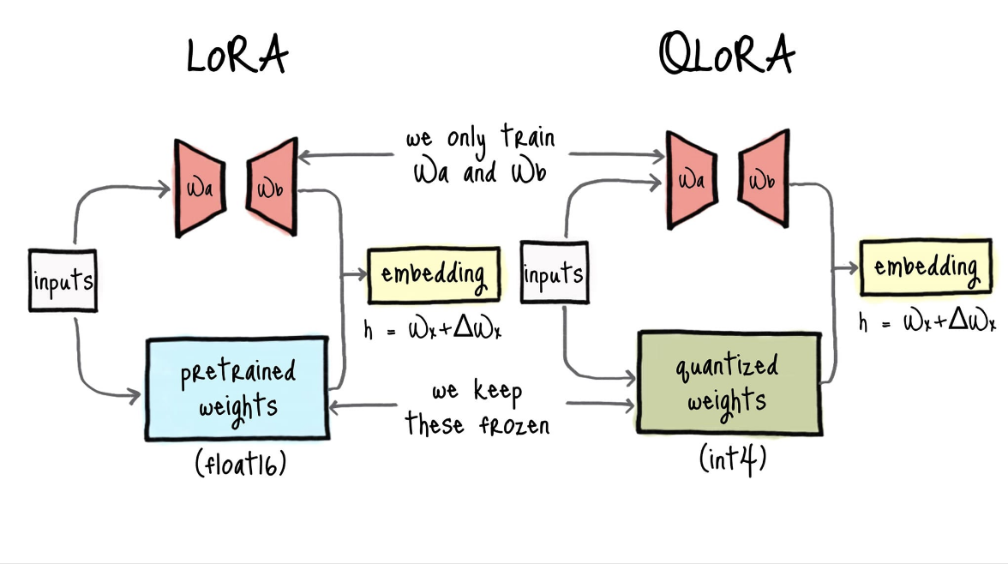
QLoRA :QUANTIZED LOW-RANK ADAPTATION
QLoRA is a technique used for fine-tuning deep neural networks, making training faster and more efficient in situations with limited computational resources.
QLoRA can be explained by breaking it down into two parts:-
Quantization:- This technique decreases the model’s precision to decrease the size it holds in the memory and the speed of processing
Low Ranking Adapters:- This technique decreases the computation size by decreasing the order of the matrices which are used to issue updates to the model weights.

Slide 44
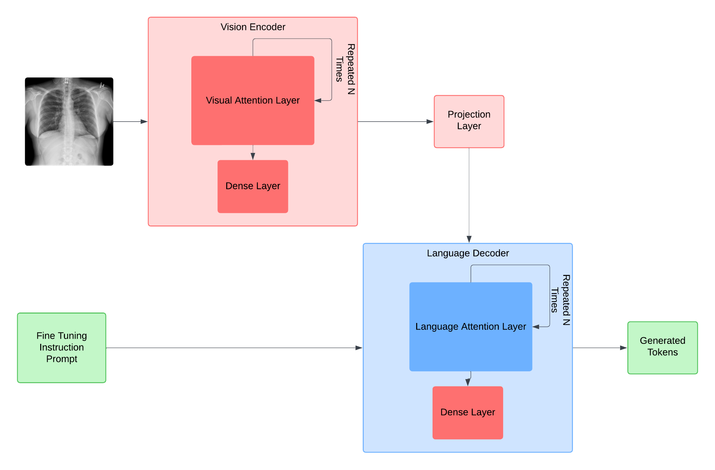
FINE TUNING PROCESS
The fine-tuning process of the VLM involves several steps, beginning with training the Vision Encoder to interpret images through its complex architecture to perform object detection and and identifying anatomical structures
VISION ENCODER
Trained to interpret the X-Ray just as a radiologist would.
The VLM was fine-tuned using QLoRA, enabling us to selectively fine-tune sections, optimizing resource utilization while maintaining overall performance.
We chose to tune the following components:
Visual Attention Layer: This Layer conducts attention over the image and creates understanding of the Input
Dense Layer: This Layer distills the gained knowledge into embeddings of set length.
What is QLora?
Method that simplifies training VLMs by reducing the size of the model using advanced compression techniques, while keeping its performance intact.

Slide 45
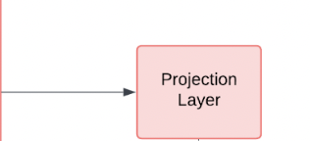
The next step is to take the information from the vision encoder and turn it into numbers that the model can understand and process.
STEP 2 : PROJECTION LAYER
Acts like a translator.
This step ensures that the model can work with different types of data to make sense of both visuals and words.

Slide 46
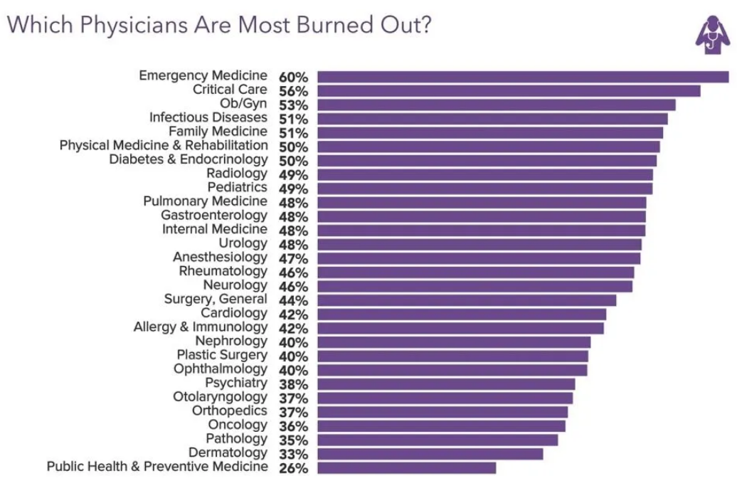
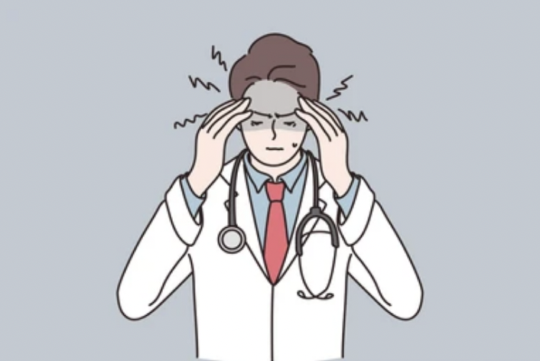
54% of Radiologists report experiencing “long-term, unresolved, job-related stress leading to exhaustion, cynicism, detachment from job responsibilities, and lacking a sense of personal accomplishment.”
High Imaging Volume
Long Work Hours
Administrative Tasks
Pressure for Accuracy

Slide 47
We have developed a highly adaptable model with personalized customization and individual user specifications and preferences.
Fine-tune the Vision Language Model overcoming GPU memory constraints.
Address computational demands with quantization techniques.
Adapt to each radiologist's distinct reporting style.
Enable personalized analysis tailored to individual preferences.
Design a supportive tool specifically for radiologists
Provide preliminary findings to streamline workflow.
Reduce time spent on routine assessments.
Notes:
1: Objectives:
Overcoming GPU memory constraints
Addressing computational demands
2 : Objectives:
Enable personalized analysis tailored to individual preferences.
Ensure communication aligns with their unique clinical approach.
3: Objectives:
Provide preliminary findings to streamline workflow.
Reduce time spent on routine assessments.
Enable radiologists to focus on complex and nuanced diagnoses.

Slide 48
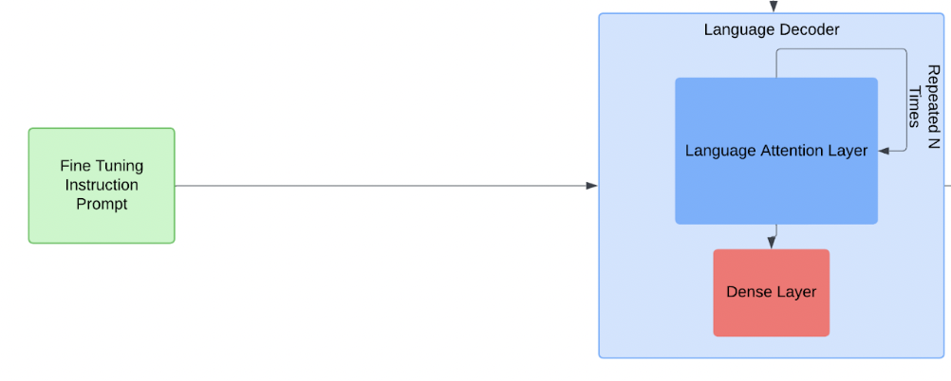
FINE TUNING PROCESS
PROMPT
The Fine Tuning Instruction Prompt refers to the Instruction given to the model informing it of its task.
LANGUAGE DECODER
In the decoder block we have kept everything frozen to maintain the model’s understanding of language.
The Final Dense Layer was unfrozen to change the most probable token at each step for our use case.
Instructs the model to communicate in the distinctive and personalized style of the doctor.
Conveys the results in the personalized tone of the radiologist utilizing the model.

Slide 49
The fine-tuning process of the VLM progresses by prompting the model and training the Language Decoder to recognize and adapt to the nuances of the radiologist's particular reporting style.
FINE TUNING PROCESS
STEP 3 : PROMPT
The Fine Tuning Instruction Prompt refers to the Instruction given to the model informing it of its task.
STEP 4 : LANGUAGE DECODER
A skilled assistant that learns how a radiologist writes and speaks.
It takes the findings and translates them into reports using the same tone, style, and language the radiologist would use, making the results personalized.
Instructs the model to communicate in the distinctive and personalized style of the doctor.
Conveys the results in the personalized tone of the radiologist utilizing the model.

Slide 50
FINE TUNING PROCESS :
Model I
The first model we created was the Image to JSON scheme model..
This model was focused on extracting and distilling the symptoms and clinical findings found in the XRAY into representative JSON Labels.
This is useful for radiologists as metadata for filtering and quick summarization.
Generated JSON labels

Slide 51
FINE TUNING PROCESS :
Model II
The second model we created was the Image to text reports scheme model.
This model was focused on understanding and capturing the symptoms and clinical findings found in the XRAY into a full radiology findings write-up of a radiology report.
It serves as a valuable tool for radiologists, enabling rapid prototyping and drafting of reports during time-sensitive scenarios.
Generated Findings

Slide 52
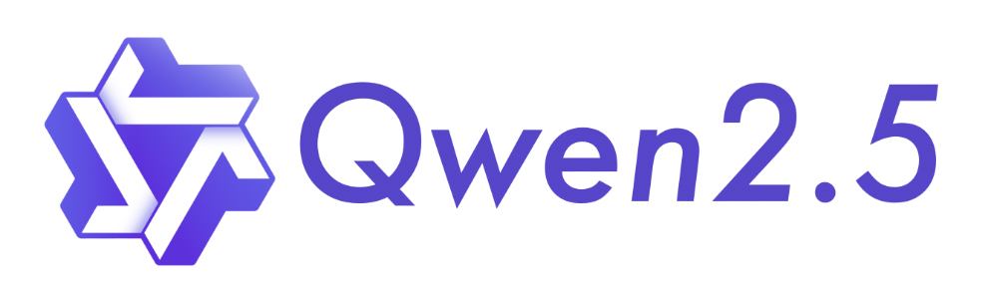
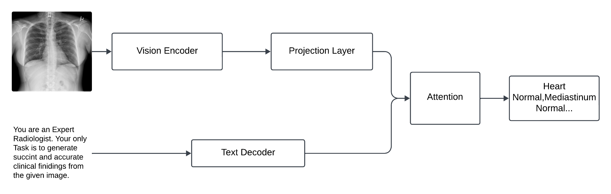
A deep dive into the VLM architecture.
Image Input
Extracts high-level visual features from X-Ray images
Maps encoded visual features into a compatible latent space
Generated JSON labels/Report Findings
Focuses on the most relevant parts of the input to enhance feature understanding and output accuracy.
Instruction Prompt
Generates descriptive or diagnostic text based on encoded visual and/or contextual input.
Image Augmentation
Text Preprocessing
Model
Selection
VLM
Finetuning
Evaluation Metrics

Slide 53
LIMITATIONS
The model currently exhibits overfitting, primarily due to the limited number of examples in the dataset, despite the use of augmentations to mitigate this issue.
Additionally, the imbalance in the dataset, with a higher proportion of normal reports compared to abnormal ones, has led the model to favor generating normal reports, reducing its accuracy in handling abnormal cases.
The model does not generate impressions, diagnoses, or treatment plans, focusing solely on findings extraction and draft preparation.
NEXT STEPS
Expand Dataset: Request access to the MIMIC-CXR dataset, which includes over 200,000 studies (both normal and abnormal), to enhance the diversity and size of the training dataset.
Optimize Model Performance: Implement model pruning techniques to create smaller, more efficient models while maintaining performance.
Integrate Aftercare Framework: Once the model achieves sufficient accuracy and reliability, develop an aftercare suggestion framework using Retrieval-Augmented Generation (RAG) to fully automate the radiology pipeline.

Slide 54
NEXT STEPS
Expand Dataset: Request access to the MIMIC-CXR dataset, which includes over 200,000 studies (both normal and abnormal), to enhance the diversity and size of the training dataset.
Optimize Model Performance: Implement model pruning techniques to create smaller, more efficient models while maintaining performance.
Integrate Aftercare Framework: Once the model achieves sufficient accuracy and reliability, develop an aftercare suggestion framework using Retrieval-Augmented Generation (RAG) to fully automate the radiology pipeline.

Slide 55
Custom Metric
Text Evaluation has had many breakthroughs with many evaluation suites coming up in recent times.
Structured Generation is more of new focus for the community hence there is not a lot of work done in this arena.
We have created our own token overlap metric for evaluating the JSON Labels generated from our model compared to the findings in the text report.
The metric works by checking if the values in the JSON key-value pairs are present in the given report acting as a check to see if we have captured all the clinical findings and symptoms in the report.

Slide 56
The three evaluation methods we use to assess the performance of both models.
Text Similarity Metrics
GLUE (General Language Understanding Evaluation): Measures the overlap between the model-generated text and reference reports, useful for short structured outputs.
ROUGE (Recall-Oriented Understudy for Gisting Evaluation): Evaluates recall-based overlaps, often used for summarization tasks.
Customized JSON Evaluation:
Semantic Understanding Metrics
BERT Precision: Measures the relevance of the retrieved tokens or segments by a BERT-based model compared to the ground truth.
BERT Recall: Evaluates how well a BERT-based model retrieves all relevant tokens or segments from the ground truth.
Human Evaluation Metrics
Expert Review Scores: Radiologists assess the quality of the generated reports based on relevance, accuracy, and comprehensiveness.

